Slide 1
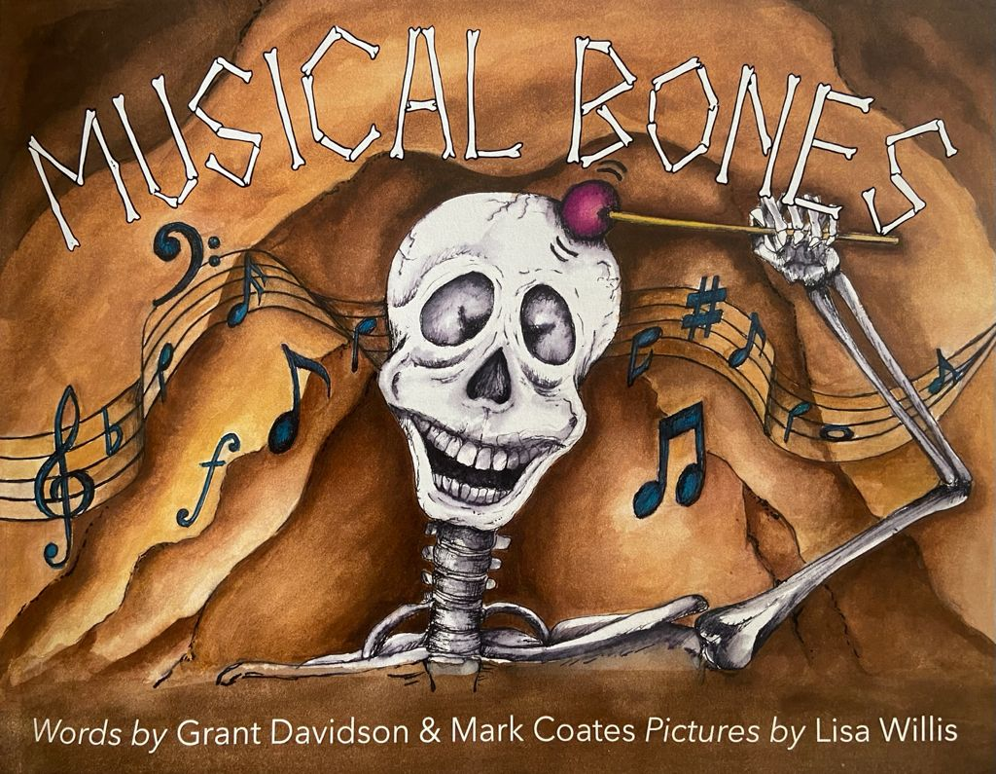
Literacy lesson: Tier 2 Vocabulary

Slide 2
We’ve tried to use lots of interesting words in Musical Bones.
This is because we think younger readers can enjoy a wide variety of words, not just simple ones. It might also give them an opportunity to learn new words they’ve never heard before.
It’s important to know a wide variety of words. Just as the variety of musical instruments in an orchestra can help composers to create beautiful harmonies, so a wide variety of words can help authors make a symphony of sounds and meanings in books!
Hopefully, this lesson will teach you how to use the Frayer model so you can understand and use more tier 2 words in your own reading and writing.
Co-authors Mark Coates and Grant Davidson.

Slide 3
We’ve tried to use lots of interesting words in Musical Bones.
This is because we think younger readers can enjoy a wide variety of words, not just simple ones. It might also give them an opportunity to learn new words they’ve never heard before.
It’s important to know a wide variety of words. Just as the variety of musical instruments in an orchestra can help composers to create beautiful harmonies, so a wide variety of words can help authors make a symphony of sounds and meanings in books!
Hopefully, this lesson will teach you how to use the Frayer model so you can understand and use more tier 2 words in your own reading and writing.
Co-authors Mark Coates and Grant Davidson.
Take a few moments to skim and scan the book Musical Bones with a partner and create a Word Bank of vocabulary you don’t regularly use when speaking (also known as Tier 2 words). Do you know what they all mean?

Slide 4
Here’s our Word Bank of Tier 2 vocabulary in Musical Bones:
anxious
auditioned
brutish
yearned
monumental
vile
loathed
domain
ambition
revered
loutish
possessed
feeble
dreaded
flair
accomplished
unique
swarming
precision
brimming
custom
Is this the most complex vocabulary of all?
“And to top off the merchandise paraphernalia”

Slide 5
We’ll look at “merchandise paraphernalia” later. For now, pick an adjective from the tier 2 words below (or one you identified yourself) and use it to make a Frayer Model (if you’ve never used this before, we’ll demonstrate how on the next slide using brutish).
Here’s our Word Bank of Tier 2 vocabulary in Musical Bones:
anxious
auditioned
brutish
yearned
monumental
vile
loathed
domain
revered
loutish
possessed
feeble
ambition
dreaded
flair
accomplished
unique
swarming
precision
brimming
custom

Slide 6
Reminder: An adjective is a word use to describe a noun. It tells you more about it.
We’ll look at “merchandise paraphernalia” later. For now, pick an adjective from the tier 2 words below (or one you identified yourself) and use it to make a Frayer Model (if you’ve never used this before, we’ll demonstrate how on the next slide using brutish).
Here’s our Word Bank of Tier 2 vocabulary in Musical Bones:
anxious
auditioned
brutish
yearned
monumental
vile
loathed
domain
revered
loutish
possessed
feeble
ambition
dreaded
flair
accomplished
unique
swarming
precision
brimming
custom

Slide 7
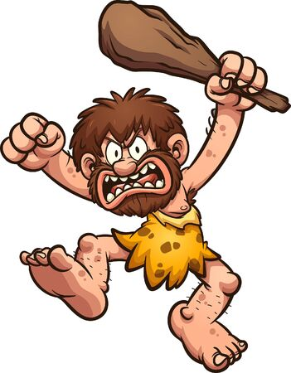
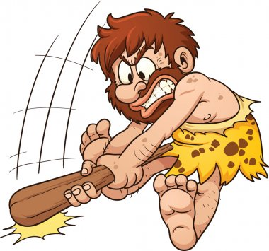
Define it: adjective resembling an aggressive animal or monster who acts without thinking. | Illustrate it:
Use it: Many of the monsters in Halloween Land were quite brutish. | Opposite: Kind, lovely, gentle, thoughtful, intelligent, sophisticated
The Frayer Model
Brutish

Slide 8
Define it: | Illustrate it:
Use it: | Opposite:
Main task: now, put your tier 2 adjective into a Frayer Model like this one:
The Frayer Model
Extension task: pick another tier 2 adjective to put into a Frayer Model

Slide 9
Reflecting on the Frayer model for adjectives. Answer the following questions:
What are the four quarters of the Frayer model for adjectives?
Which one did you enjoy filling out the most?
In what ways might the Frayer model be useful when learning new vocabulary?
Do you think you might use it again?
Let’s use it one more time for these two words: ‘merchandise’ and ‘paraphernalia.’ However, as both of these words are nouns, we’ll change the ‘opposite’ quarter to ‘link it’ which should make things easier. Let’s go to the next slide and see…
Reminder: A noun is the name of any object, person, animal, thing, idea or place.

Slide 10
Define it: | Illustrate it:
Use it: | Link it:
Main task: now, try completing this Frayer model for ‘merchandise.’
The Frayer Model
Merchandise
Extension task: start putting ‘paraphernalia’ into a Frayer Model

Slide 11
Define it: noun goods in a shop or outlet to be bought and sold. | Illustrate it:
Use it: | Link it:
The Frayer Model
Merchandise

Slide 12
Define it: noun goods in a shop or outlet to be bought and sold. | Illustrate it:
Use it: There was a wide range of Sidney merchandise for sale. | Link it: Shops, gifts, goods, products, salesperson, market, retail
The Frayer Model
Merchandise

Slide 13
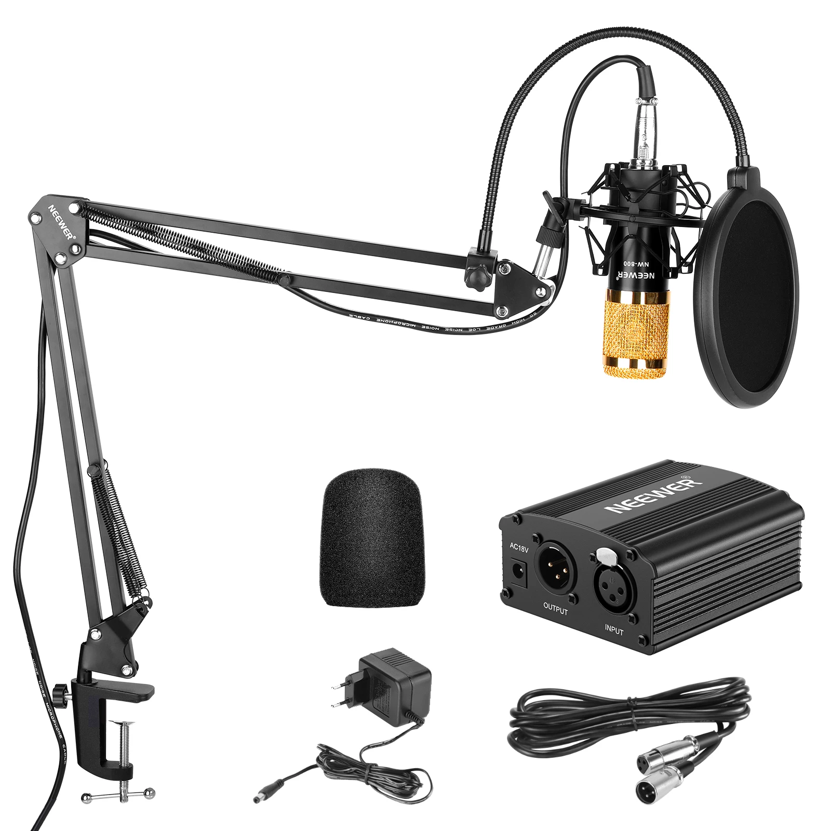
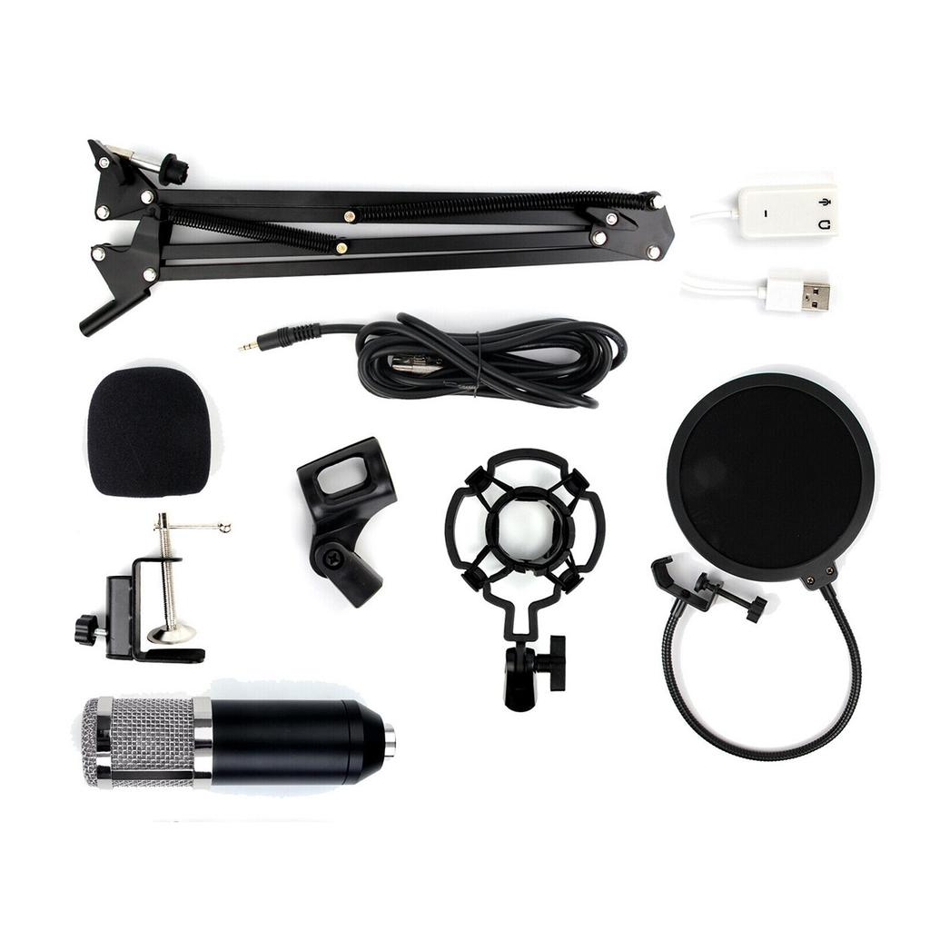
Define it: noun ‘bits and pieces’ or equipment related to a particular person, group, event or activity | Illustrate it:
Use it: | Link it:
The Frayer Model
Paraphernalia

Slide 14
Define it: noun ‘bits and pieces’ or equipment related to a particular person, group, event or activity | Illustrate it:
Use it: A variety of technical paraphernalia was used by the orchestra such as assorted microphones, stands and wires. | Link it: Equipment, stuff, kit, tools, things, rig, utensils, bits and pieces
The Frayer Model
Paraphernalia

Slide 15
Reflecting on the Frayer model for nouns. Answer the following questions:
Why is it difficult to think of an ‘opposite’ for nouns?
Do you know the difference between synonyms and antonyms?
Other than rhyme, what other reason might an author have for using ‘paraphernalia’ instead of ‘bits and pieces’ or ‘equipment’?
Now think about all the words you’ve looked at today.
Which words were ‘new words’ for you that you’ve learned for the first time?
Which word was your favourite and why?
Do you think it’s useful to have a wide vocabulary when speaking to people? If so, why?
Which types of writing would you use a range of adjectives in and why?
If you have a wide vocabulary, how can that help you when reading?

Slide 16
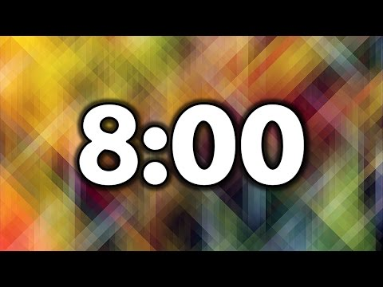
Final task: to end with, try writing a 50 word story with as many of these words in as possible… you have 8 minutes!
monumental
paraphernalia
loathed
revered
unique
accomplished
brutish
vile
anxious
loutish
dreaded
ambition
yearned
domain
swarming
feeble
flair
precision
brimming
merchandise
custom

Slide 17
Did you learn any new words?
Was the Frayer model helpful?
Why is it helpful to have a wide vocabulary?

